Slide 1
Kappa Architecture
Pravin Y Pawar

Slide 2
Bad thing about Lambda Architecture
The problem with the Lambda Architecture is that maintaining code that needs to produce the same result in two complex distributed systems is exactly as painful as it seems like it would be.
Programming in distributed frameworks like Storm and Hadoop is complex. Inevitably, code ends up being specifically engineered toward the framework it runs on. The resulting operational complexity of systems implementing the Lambda Architecture is the one thing that seems to be universally agreed on by everyone doing it.
Interesting read : https://www.oreilly.com/ideas/questioning-the-lambda-architecture

Slide 3
Kappa Architecture
Defined
First described by Jay Kreps at Linkedin.
It focuses on only processing data as a stream.
It is not a replacement for the Lambda Architecture, except for where your use case fits.
For this architecture, incoming data is streamed through a real-time layer and the results of which are placed in the serving layer for queries.

Slide 4
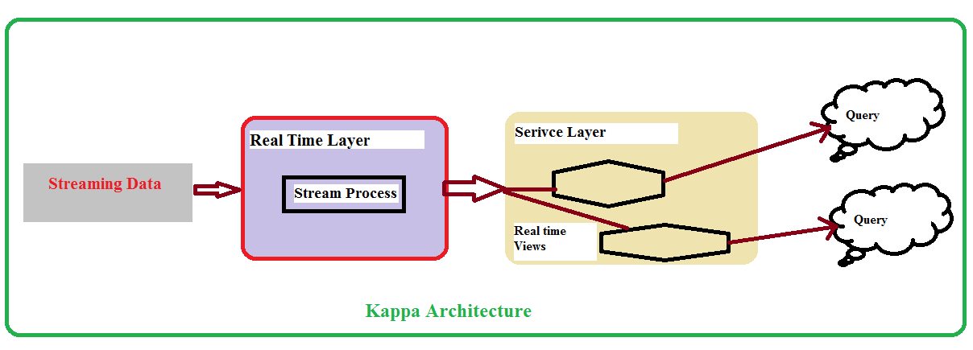
Kappa Architecture (2)
Block Diagram

Slide 5
Kappa Architecture (3)
The idea is to handle both real-time data processing and continuous reprocessing in a single stream processing engine.
This requires that the incoming data stream can be replayed (very quickly), either in its entirety or from a specific position.
If there are any code changes, then a second stream process would replay all previous data through the latest real-time engine and replace the data stored in the serving layer.
This architecture attempts to simplify by only keeping one code base rather than manage one for each batch and speed layers in the Lambda Architecture.
In addition, queries only need to look in a single serving location instead of going against batch and speed views.
Interesting read : https://www.talend.com/blog/2017/08/28/lambda-kappa-real-time-big-data-architectures/

Slide 6
Pros and Cons of Kappa architecture
Pros
Kappa architecture can be used to develop data systems that are online learners and therefore don’t need the batch layer.
Re-processing is required only when the code changes.
It can be deployed with fixed memory.
It can be used for horizontally scalable systems.
Fewer resources are required as the machine learning is being done on the real time basis.
Cons
Absence of batch layer might result in errors during data processing or while updating the database that requires having an exception manager to reprocess the data or reconciliation.
Interesting read : https://towardsdatascience.com/a-brief-introduction-to-two-data-processing-architectures-lambda-and-kappa-for-big-data-

Slide 7
Thank You!
In our next session: Streaming Data Systems Components

